Slide 1
iVAE – GAN: Identifiable VAE-GAN Model for Latent Representation Learning

Slide 2
List of Contents
Autoencoders
What is Autoencoder?
Methodology of Autoencoders
Examples where Autoencoders
VAE – Variational Autoencoders
About VAE
Example of VAE
GAN – Generative Adversarial Network
About GAN
Training the Discriminator
Training the Generator
Example of GAN
Introducing VAE – GAN
Applications of VAE-GAN

Slide 3
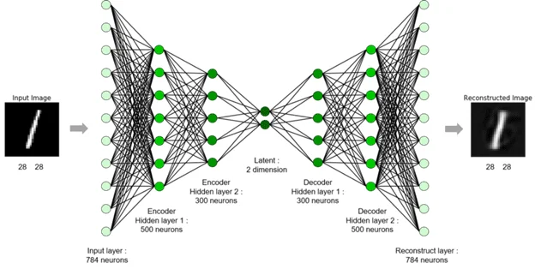
What is Auto Encoder?
The autoencoder encode the image into latent space Z through encoder and reconstruct the image through decoder. The latent space Z is usually low dimensional. We can explain in simple terms as, it is a process of compressing input data by encoding it, and then reconstructing it as an output, autoencoders allow you to reduce dimensionality and focus only on areas of real value.

Slide 4
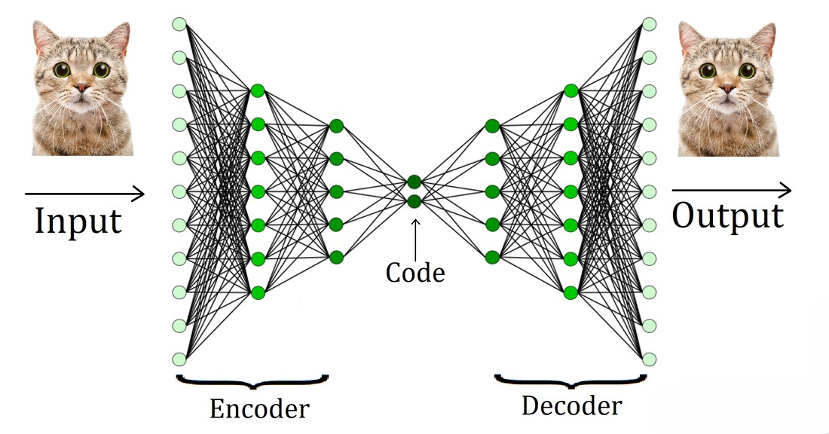
Methodology of Auto Encoders
Autoencoders are trained end-to-end by having the decoder attempt to reconstruct the original input from the encoder's intermediate format as closely as possible. Because the intermediate format is smaller (lower-dimensional) than the original format, the autoencoder is forced to learn what information in the input is essential, and the output won't be perfectly identical to the input. Here the system that learns to extract the most important information from the input. As it is a combination of an encoder and decoder, autoencoders rely on the following two step process:
1. The encoder maps the input to a (typically) lossy lower-dimensional (intermediate) format.
2. The decoder builds a lossy version of the original input by mapping the lower-dimensional format to the original higher-dimensional input format.

Slide 5
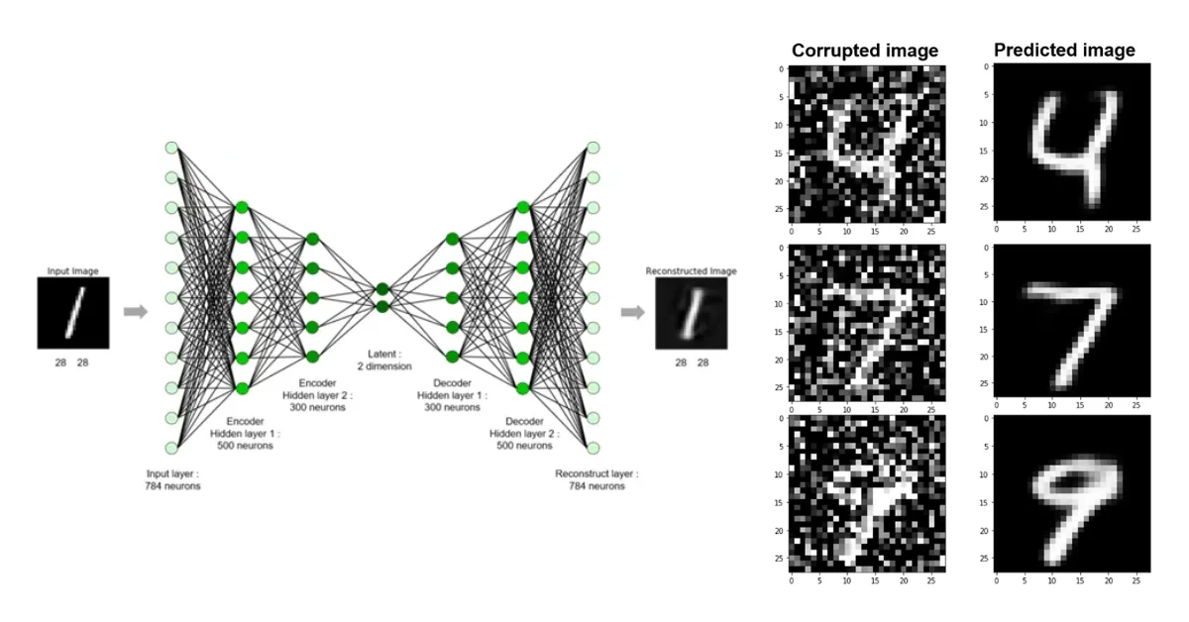
Examples where Autoencoder Used
If the input data is a graphic, the non-exact copy would be similar to the original graphic, but somewhat modified. For example, perhaps the non-exact copy removes noise from the original graphic or fills in some missing pixels.
Uploading a content to cloud, where it actually gets stored in a compressed manner, and when you are trying to access it decompresses the photo to the original size.
Can also be used for denoising and neural inpainting

Slide 6
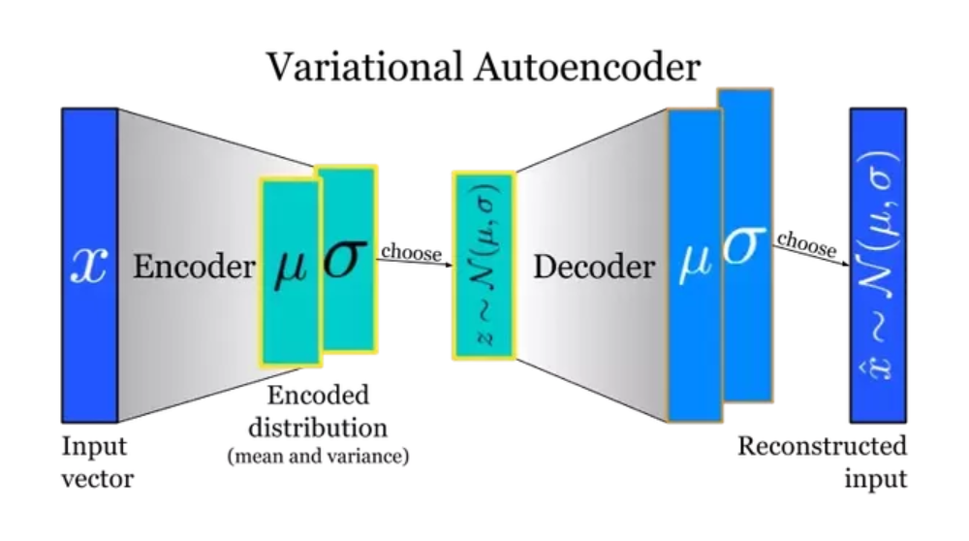
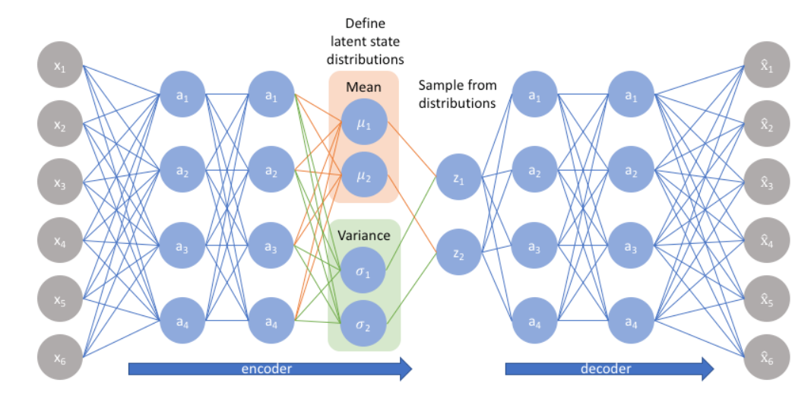
Variational Autoencoders
Instead of mapping to fixed vector, you want to map the inputs to distribution, the difference is the bottle neck vector Z is replaced by two separate vectors one representing mean of the distribution and the other one representing standard deviation of the distribution. When ever you need a vector to feed to the decoder network the only thing you have to do is to take a sample from the distribution and then feed it to the decoder.

Slide 7
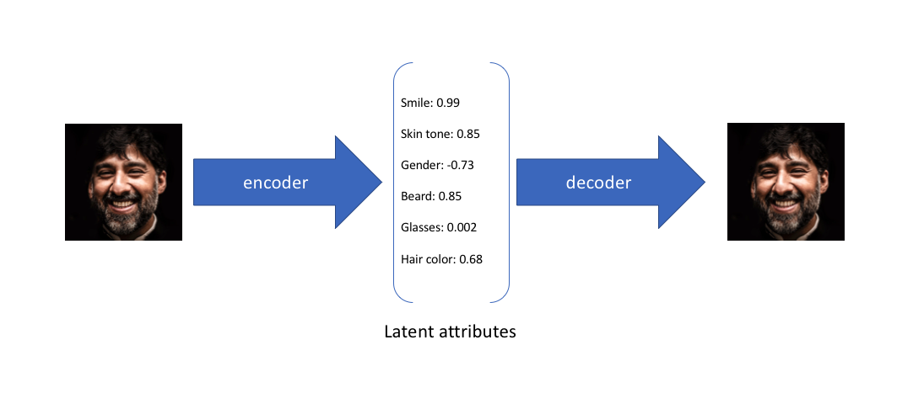
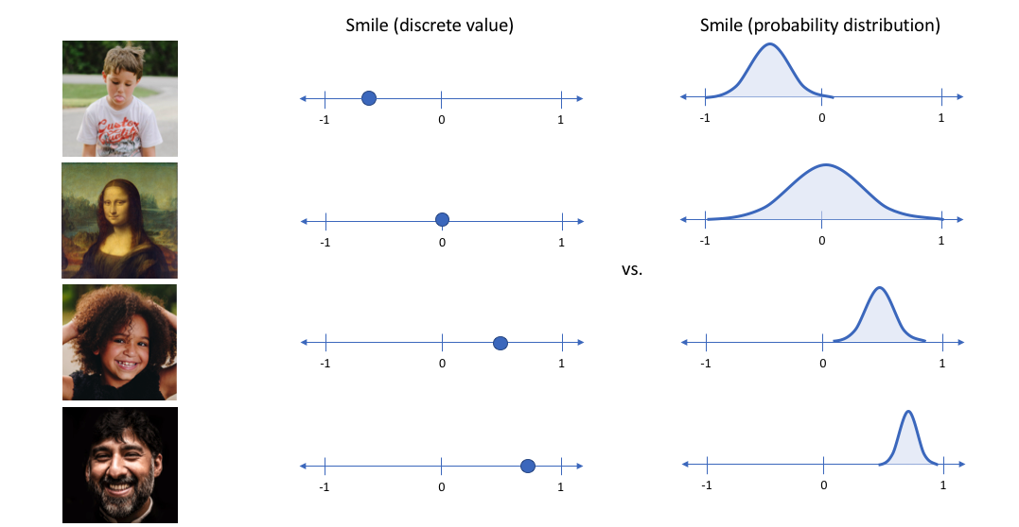
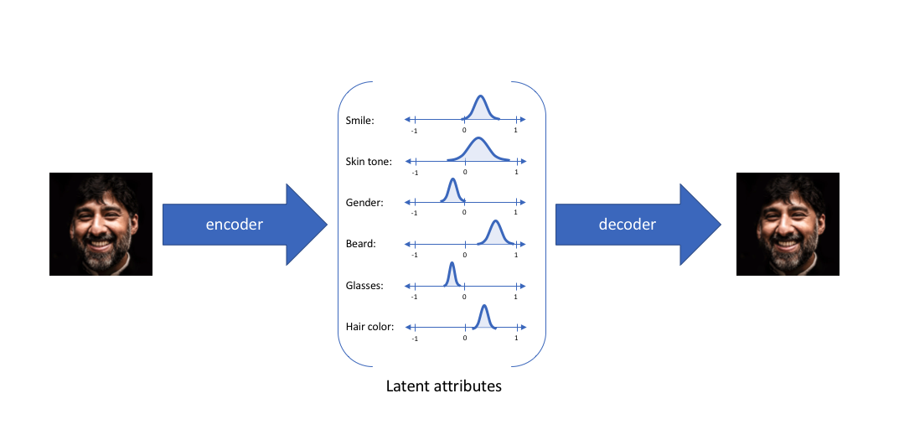
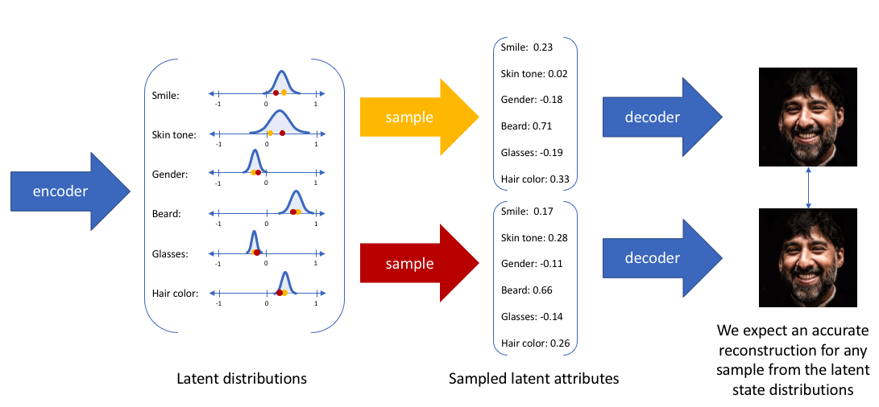
Example of VAE

Slide 8
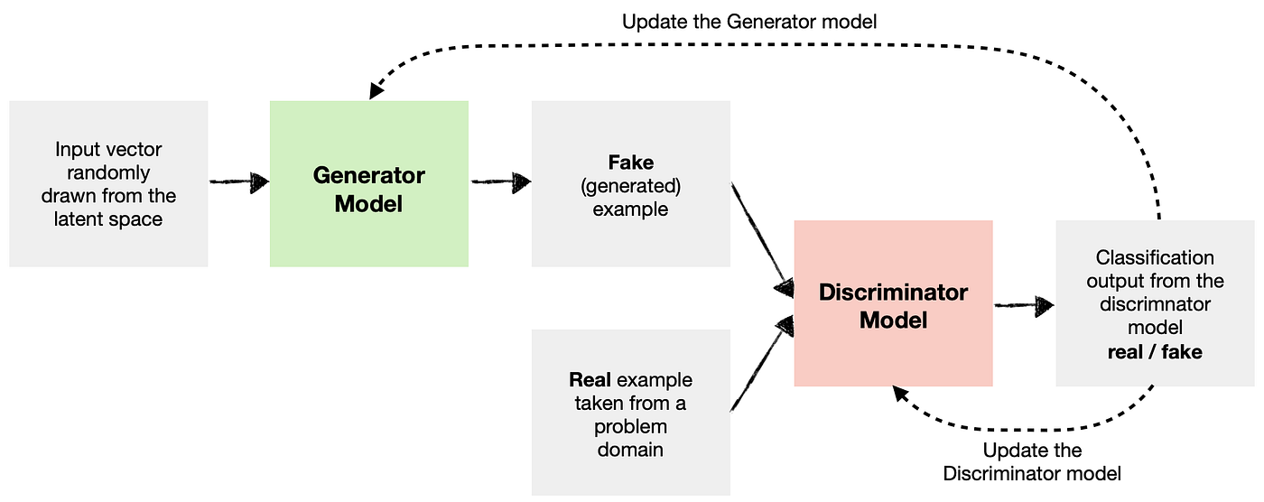
Generative Adversarial Networks
A generative adversarial network (GAN) has two parts:
1. The generator learns to generate plausible data. The generated instances become negative training examples for the discriminator.
2. The discriminator learns to distinguish the generator's fake data from real data. The discriminator penalizes the generator for producing implausible results.
When training begins, the generator produces obviously fake data, and the discriminator quickly learns to tell that it's fake:
1. As training progresses, the generator gets closer to producing output that can fool the discriminator.
2. Finally, if generator training goes well, the discriminator gets worse at telling the difference between real and fake. It starts to classify fake data as real, and its accuracy decreases.

Slide 9
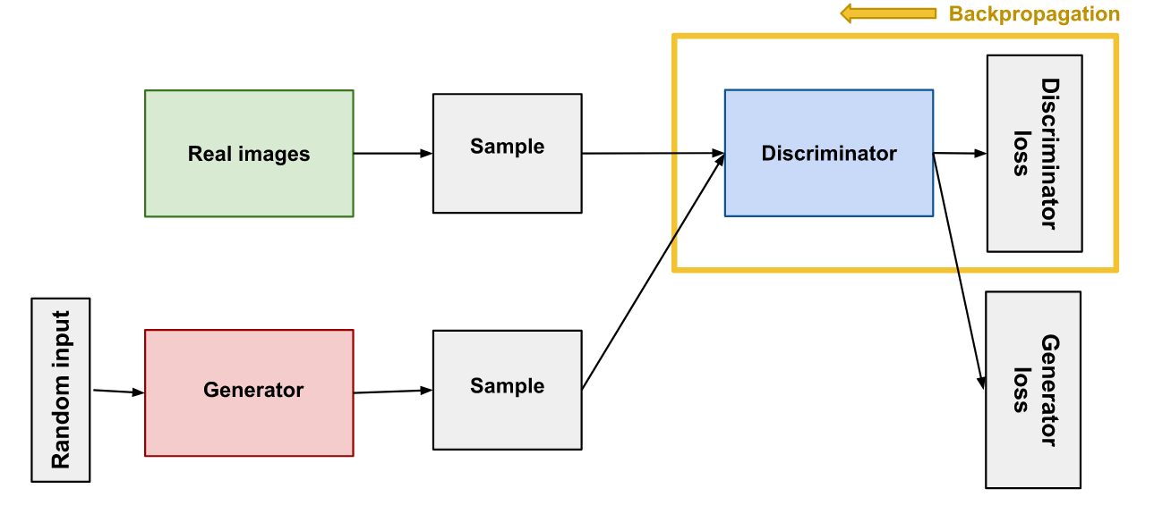
Training the Discriminator
The discriminator connects to two loss functions. During discriminator training, the discriminator ignores the generator loss and just uses the discriminator loss. We use the generator loss during generator training.
During discriminator training:
1. The discriminator classifies both real data and fake data from the generator.
2. The discriminator loss penalizes the discriminator for misclassifying a real instance as fake or a fake instance as real.
3. The discriminator updates its weights through backpropagation from the discriminator loss through the discriminator network.

Slide 10
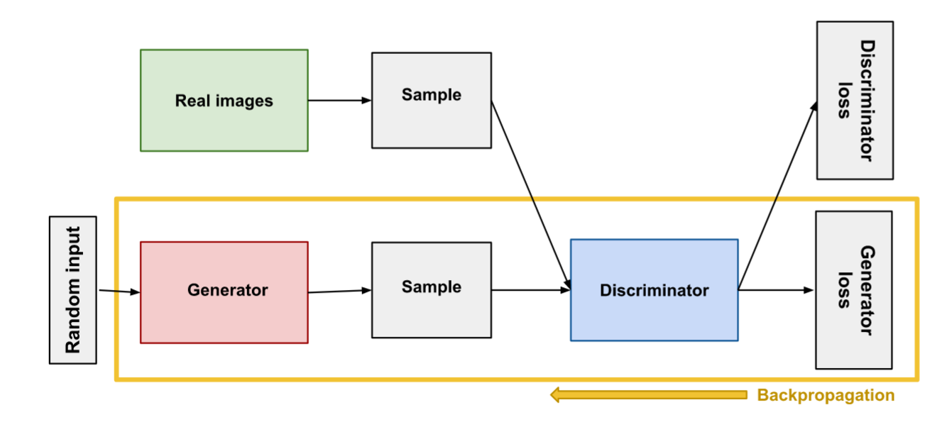
Training the Generator
Generator training requires tighter integration between the generator and the discriminator than discriminator training requires. The portion of the GAN that trains the generator includes:
Random input
generator network, which transforms the random input into a data instance
discriminator network, which classifies the generated data
discriminator output
generator loss, which penalizes the generator for failing to fool the discriminator

Slide 11
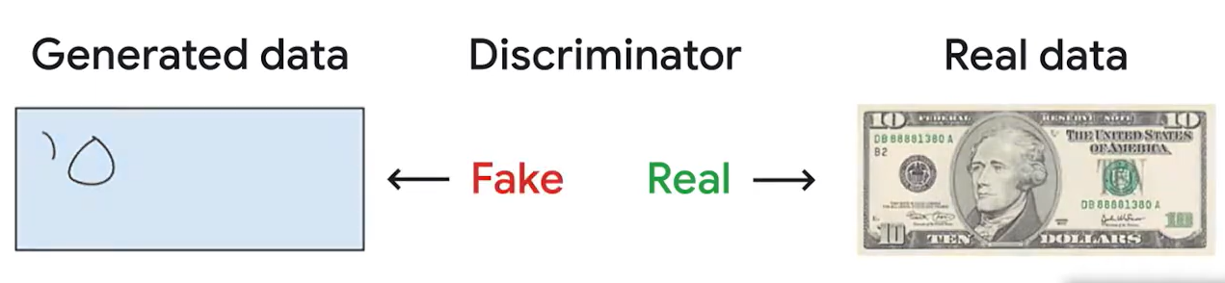
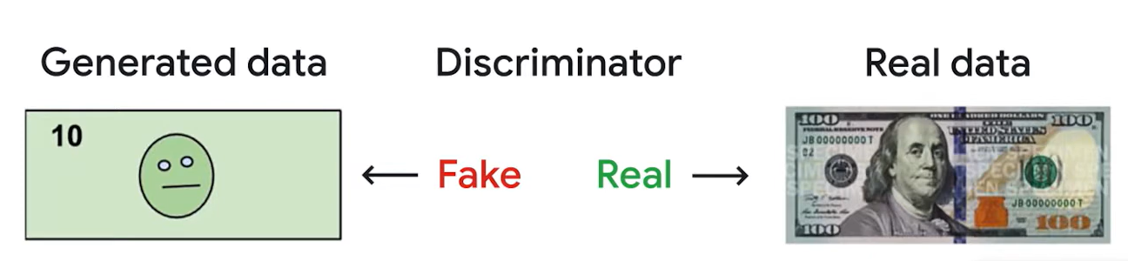
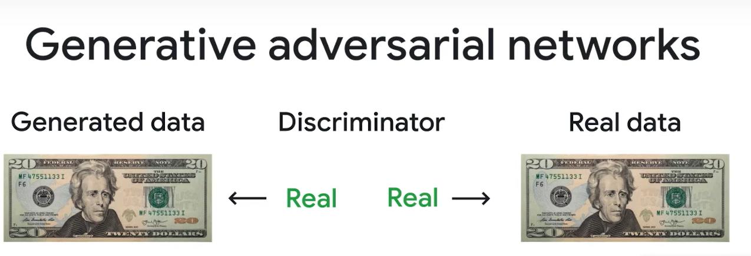
Example of GAN

Slide 12
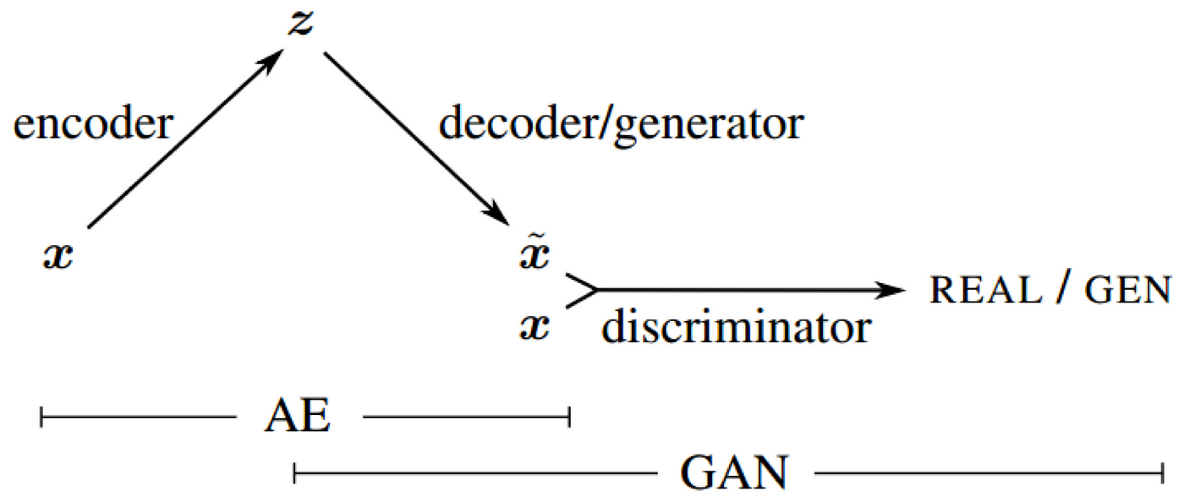
Introducing VAE with GAN
Introducing VAE with GAN
A VAE-GAN combines the concepts of VAE and GAN in an attempt to leverage the benefits of both models.
VAE-GANs have been applied in various domains, including image generation, data denoising, and more, and they are often used when a balance between structured latent representations and high-quality data generation is required.

Slide 13
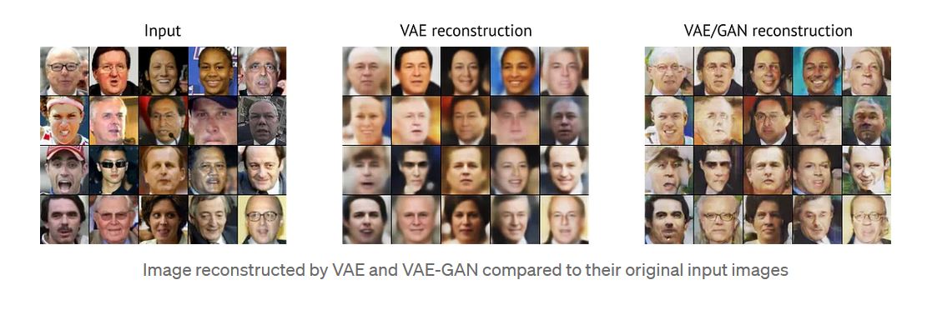
Application of VAE-GAN
Generate Cartoon Characters
Generate Examples for Image Datasets

Slide 14
THANK YOU

